Slide 1
Teck Ghee Horizon A41

Slide 2
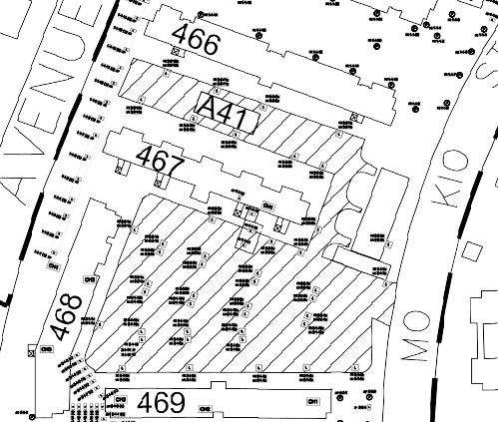
Block A40 CAR PARK SPACE PLAN

Slide 3
466
Ang Mo Kio Ave 10
A41
467
Ang Mo Kio Street 44
A41
468
469

